Slide 1
Software Design & Architecture
Week 07
Abeeha Sattar

Slide 2
Activity Diagrams
Chapter # 9
(Applying UML and Patters, 3rd Edition)

Slide 3
What is an Activity Diagram
Represent the dynamic (behavioral) view of a system
Used for business (transaction) process modeling and modeling the logic captured by a single use-case or usage scenario
Used to represent flow across use cases or within a use case
UML activity diagrams are the object oriented equivalent of flow chart and DFDs in function-oriented design approach
Describes how activities are coordinated.
Records the dependencies between activities, such as which things can happen in parallel and what must be finished before something else can start.
Represents the workflow of the process.
Activity diagram contains activities, transitions between activities, decision points, synchronization bars, swim lanes and many more.

Slide 4





Notation
2. Transition
Activity1
Activity2
1. Activities

Slide 5




Notation
[x>0]
[x>0]
Activity1
[x=0]
[x=0]
[x<0]
[x<0]
3. Decision Diamond

Slide 6


Notation
4.1 Synch. Bar (Join)
4.2 Splitting Bar (Fork)

Slide 7



Notation
Start Marker
Stop Marker
5. Start & Stop Markers

Slide 8





Notation
Developers
Testers
Markers
Swimlane
Swimlane
Swimlane
Application/Department/Group/Role Boundaries

Slide 9
















Activity Diagram for Library
member [borrower]
Librarian
Find book on shelf
[returning]
[returner]
Wait in queue
[borrowing]
Record return
Put book back to shelf
Record borrowing
Prepare for next member

Slide 10
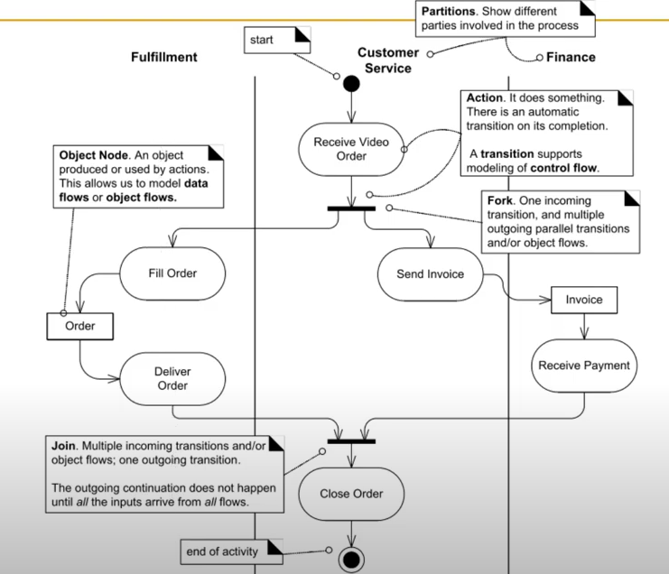

Slide 11
Why Activity Diagrams?
To model the dynamic aspects of a system
It is essentially a flowchart
Showing flow of control from activity to activity
Purpose
Model business workflows
Model operations

Slide 12
Activity Diagrams
Activity diagrams commonly contain
Activity states and action states
Transitions
Objects

Slide 13
Action State
Represents the execution of an atomic action, typically the invocation of an operation.
Work of the action state is not interrupted

Slide 14
Transition State
When the action or activity of a state completes, flow of control passes immediately to the next action or activity state
A flow of control has to start and end someplace
initial state -- a solid ball
stop state -- a solid ball inside a circle

Slide 15
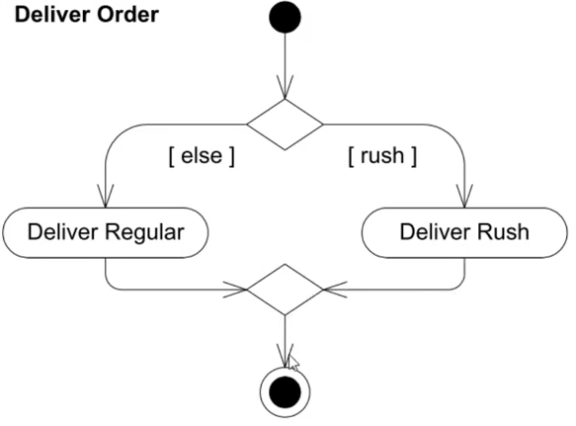
Branching
A branch specifies alternate paths taken based on some Boolean expression
A branch may have one incoming transition and two or more outgoing ones

Slide 16
Forking and Joining
Use a synchronization bar to specify the forking and joining of parallel flows of control
A synchronization bar is rendered as a thick horizontal or vertical line

Slide 17
Forking and Joining
A fork may have one incoming transitions and
two or more outgoing transitions
each transition represents an independent flow of control
conceptually, the activities of each of outgoing transitions are concurrent
either truly concurrent (multiple nodes)
or sequential yet interleaved (one node)

Slide 18
Forking and Joining
A join may have two or more incoming
transitions and one outgoing transition
above the join, the activities associated with each of these paths continues in parallel
at the join, the concurrent flows synchronize
each waits until all incoming flows have reached the join, at which point one flow of control continues on below the join

Slide 19
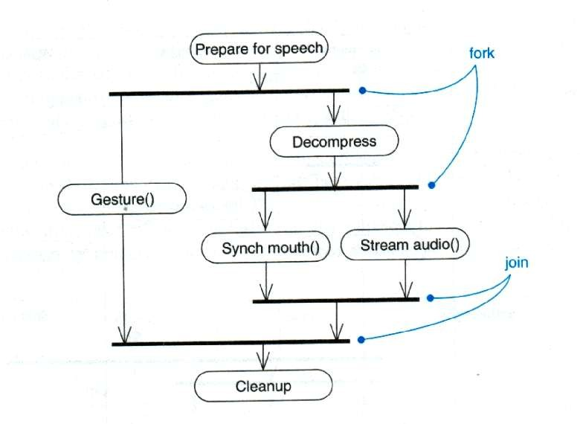
Forking and Joining

Slide 20
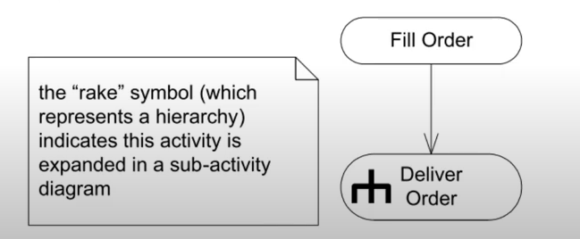
The Rake Symbol

Slide 21
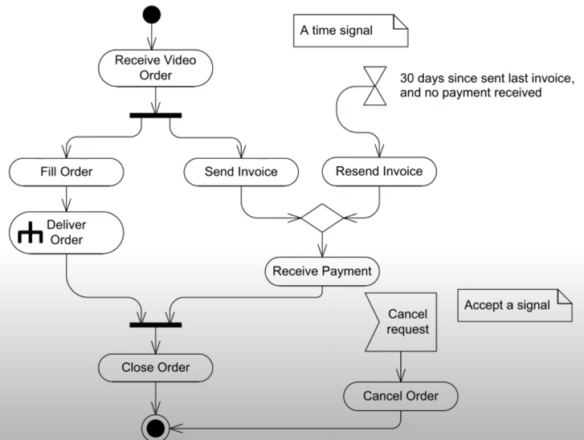
Time Signal Notation

Slide 22
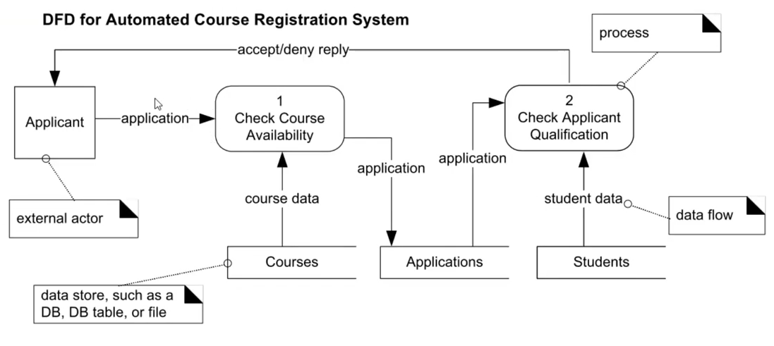
DFD (Data Flow Diagram)

Slide 23
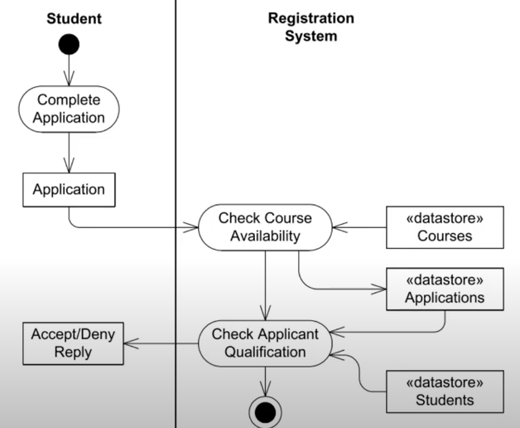
Activity Diagram

Slide 24
Fin.

